Slide 1
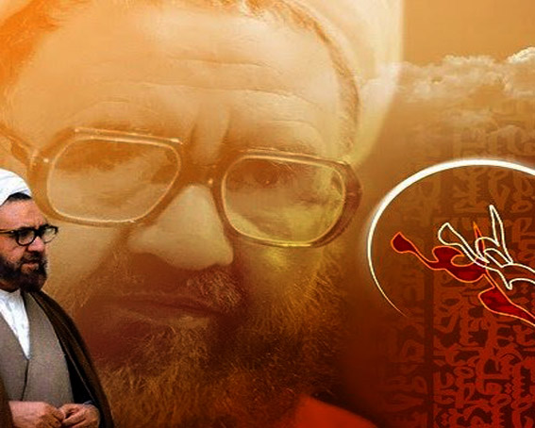
AQAL
Ustaad Shaheed Murtaza Mutahri
PARTS:
1. AQAL OR DIL 2. BUSHR’A AQAL OR MARFAT-E-ILAHI

Slide 2
AQAL OR DIL

Slide 3
CONTENTS:
* Insan K Wo Pehlu Jo Us Ki Fa’aliyat Mein Moasar Hoty Hein * Ek sarchashma Or Mutawaqqe Tanaz’a. * Aqal K Hukum Par Dil Ka Asar. * Apni Zaat Par Husn E Zann Rakhna Or Dosro Ko Malamat Karna Salah Mashirah. * Islam Or Aqli Pehlu Ki Pabandi Karna. * Ikhlaki Ehyliyat Hasil Karny K Lye. * Key Point

Slide 4
INSAN K WO PEHLU JO US KI FAALIYAT MEIN MOASAR HOTY HEIN
Insan mein 2 markazi qutub hoty hein jo us ki amli sargarmio or roohani tajalliyat ko (control) karty hein. 1. Aqal 2. Dil

Slide 5
1. AQAL
Isey Hikmat-e-danai Bhi Kaha Jata Hai
Ye Ghor-o-fikar Or Dor Andeshi Ka Sarchashma Hai
Insan K Is Pehlu Sy Hidayat Or Noor Ki Kirny Phootti Hai Example: Traffic Signal

Slide 6
2. Dil
Ye Chahat-o-raghbat, Piyar, Muhabbat, Tamanna Or Ehsas Jesi Roohani-o-nafsani Tajalliyat Ka Sarchashma Hein
Ye Dono Quwwaten Har Insan Ki Tamam Harkat-o-saknat Ko Qabo Me Rakhti Hein

Slide 7
EK SARCHASHMA OR MUTAWAQQA TANAZA
Ye Dono Quwwaten AQAL Or DIL Kbhi Ek Dosry K Mowafiq Hoti Hein
Kbhi Kbhi In Dono Quwwaten K Darmiyan Tanaza Peda Hojata Hein. Example: Parents

Slide 8
AQAL K HUKUM PAR DIL KA ASAR
Bila Shuba AQAL Dar Haqeeqat Insan K Daakhli Maidan Or Mehekmay Mein Ek Judge Ki Heysiyat Rakhti Hai
Isi Liye Ye Esi Quwwat Hai Jo Insan K Iqdamaat Par In K Sahi Ya Ghalat Hony Ka Hukum Saadir Krti Hai
Agar AQAL Qalb K Zer e Asar Hogi To Wo Judge Jald Hi Haq Sy Baar guzirishta Hojaye Ga. Example:
Insan - Khowahish

Slide 9
APNI ZAT PAR HUSN-E-ZUN RUKHNA OR DOSRO KO MALAMAT KARNA
Kbhi kbhi DIL apni khuwaish ki takmeel krwany k lye AQAL pr jabrann haawi hojata hai
Is ki waja ye hai k insan k baatin me chupi hui jabillato mein sy ek eham jabillat khud pasandi hai
Yehi waja hai k wo apny buray amal ko naik janta hai

Slide 10
APNI ZAT PR HUSN-E-ZANN,DOSRO KO MALAMAT KARNA OR SALAH MASHIRAH
Apni Zaat Par Husn-e-zann Or Dosro Sy Bad-gumani Karna Is Qadar Samaji Masail Ka Shikar Kr Dyta Hai K Jin Ka Shumaar Nahi
Wo Mashrati Adal-o-Inaf Krny Mein Rukawat Bun Jata Hai
Insan Ko Chahye K Wo Apny Nafs Ko Shirk Mein Mubtila Hony Sy Mehfooz Rkhty Hue Is Par Hamesha So-e-zann Rakhey
Mola Ali ( A.S ):
Momin Ka Nafs Subha-o-sham Guman Karta Hai

Slide 11
ISLAM OR AQLI PEHLU KI PABANDI KARNA
Islam Is Lye Aya Tha K Esy Insan Ko Azad Kra Saky Jo Apny Nafs K Samny Dub Jata Hai
Islam Is Lye Aya Tha K In Pabandio Or Beriyo Ko Tor Daaly Jo Logo Ki Aqlo Ko Qaid Mein Rakhy Hue Hai
Islam Is Lye Aya Tha K In Ka Bojh Utary

Slide 12
IKHLAKI EHLIYAT HASIL KARNY K LIYE.
Is Me Koi Shak Nahi Hai K Nafs K Sath Jung Karny Ki Salahiyaten Achanak Hasil Nahi Joti Hain: Marhala 1 Insan Ki Ye Zimmedari Hai K Wo Apni Umango Or Khuwahishat K Samny Dat Jae Marhala 2 Nafs-e-ammara Pr Mukamal Ghalba Hasil Karna Hai

Slide 13
KEY POINT
DIL-O-DIMAGH k darmiyan tamam maamilat mein AQAL ki taraf rajo’ karyen

Slide 14
THANK YOU

